Slide 1
Lead Scoring Case Study using logistic regression
Submitted By –
1. Prasanna Kaigude
2. Sai Vamsi Aritakula
3. Chanda Uday Kumar
4. Yash Chauhan

Slide 2
Contents
Problem statement
Problem approach
EDA
Correlations
Model Evaluation
Observations
Conclusion

Slide 3
Problem Statement
An education company named X Education sells online courses to industry professionals. On any given day, many professionals who are interested in the courses land on their website and browse for courses. They have process of form filling on their website after which the company that individual as a lead.
Once these leads are acquired, employees from the sales team start making calls, writing emails, etc. Through this process, some of the leads get converted while most do not.
The typical lead conversion rate at X education is around 30%. Now, this means if, say, they acquire 100 leads in a day, only about 30 of them are converted. To make this process more efficient, the company wishes to identify the most potential leads, also known as Hot Leads.
If they successfully identify this set of leads, the lead conversion rate should go up as the sales team will now be focusing more on communicating with the potential leads rather than making calls to everyone

Slide 4
Business Objective
Lead X wants us to build a model to give every lead a lead score between 0 -100 . So that they can identify the Hot leads and increase their conversion rate as well.
The CEO want to achieve a lead conversion rate of 80%.
They want the model to be able to handle future constraints as well like Peak time actions required, how to utilize full man power and after achieving target what should be the approaches.

Slide 5
Problem approach
EDA
Feature scaling
Correlations
Model Building (RFE R-squared VIF and pvalues)
Model Evaluation
Making predictions on test set
Importing the data and inspecting the data frame
Data preparation
Dummy variable creation
Test-Train split

Slide 6
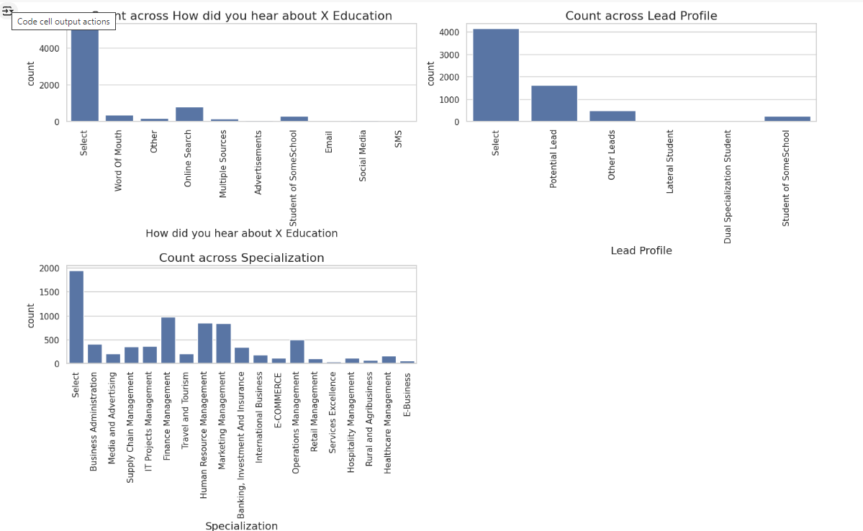
EDA – Data Cleaning
"In certain columns, there is a category labeled 'Select' that is responsible for managing specific tasks."

Slide 7
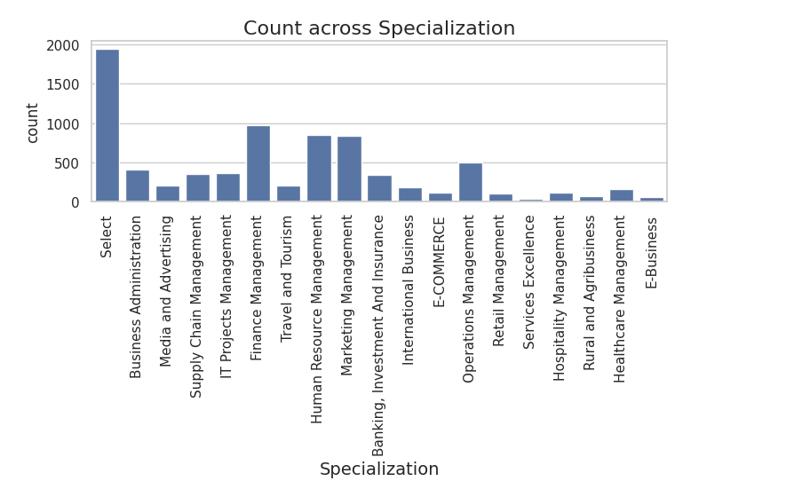
Specialization
Leads specializing in HR, Finance, and Marketing Management have a higher likelihood of conversion.

Slide 8
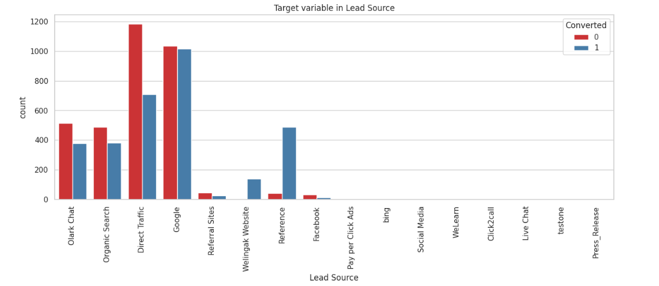
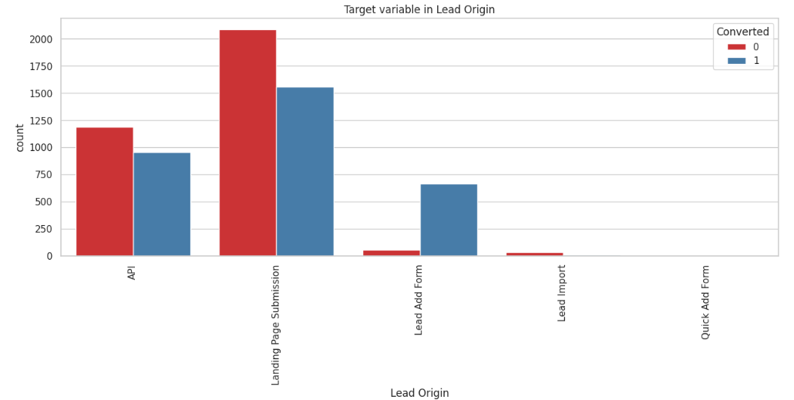
Lead source and lead origin
Leads obtained through Google and direct traffic have a higher likelihood of conversion. Meanwhile, the majority of leads originate from submissions.

Slide 9
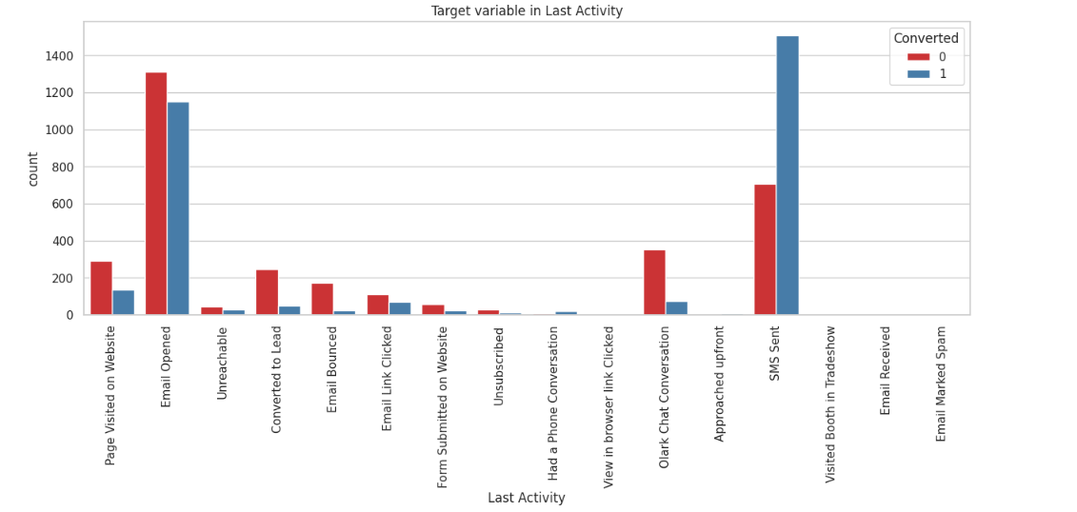
Last lead activity
Leads that open emails have a high probability of converting, and similarly, sending SMS messages also proves beneficial for conversions.

Slide 10
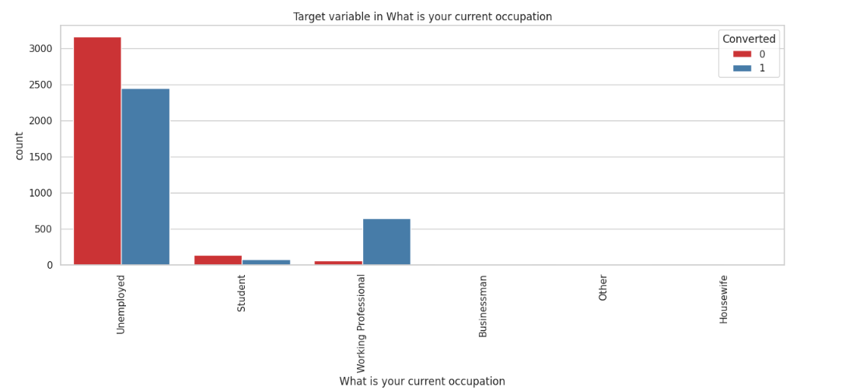
Occupation
Leads which are unemployed are most interested to join the course than others

Slide 11
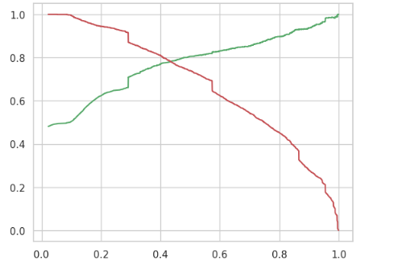
Model evaluation

Slide 12
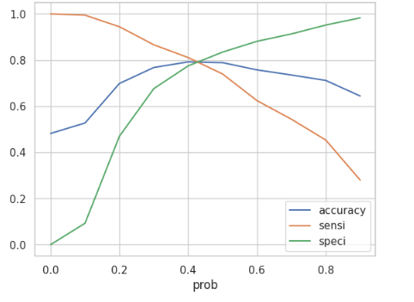
ROC curve
"Given that 0.42 represents the tradeoff between Precision and Recall, we can confidently decide to focus on any prospect lead with a conversion probability greater than this threshold."

Slide 13
Observations
Train Data:
Accuracy – 80%
Sensitivity – 77%
Specificity – 80%
Test Data:
Accuracy – 80%
Sensitivity – 77%
Specificity – 80%
Final Features list:
Lead Source_Olark Chat
Specialization_Others
Lead Origin_Lead Add Form Lead Source_Welingak Website Total Time Spent on Website Lead Origin_Landing Page

Slide 14
Conclusion
We see that the conversion rate is 30-35% (close to average) for API and Landing page submission. But very low for Lead Add form and Lead import. Therefore we can intervene that we need to focus more on the leads originated from API and Landing page submission.
We see max number of leads are generated by google / direct
traffic. Max conversion ratio is by reference and welingak website.
Leads who spent more time on website, more likely to convert.

Slide 15
THANK YOU

